Slide 1
Dealing with Uncertainty in Statics

Slide 2
Outline
Uncertainty in statics
Why consider uncertainty
Basics of uncertainty
Uncertainty analysis in statics
Examples
Conclusions

Slide 3



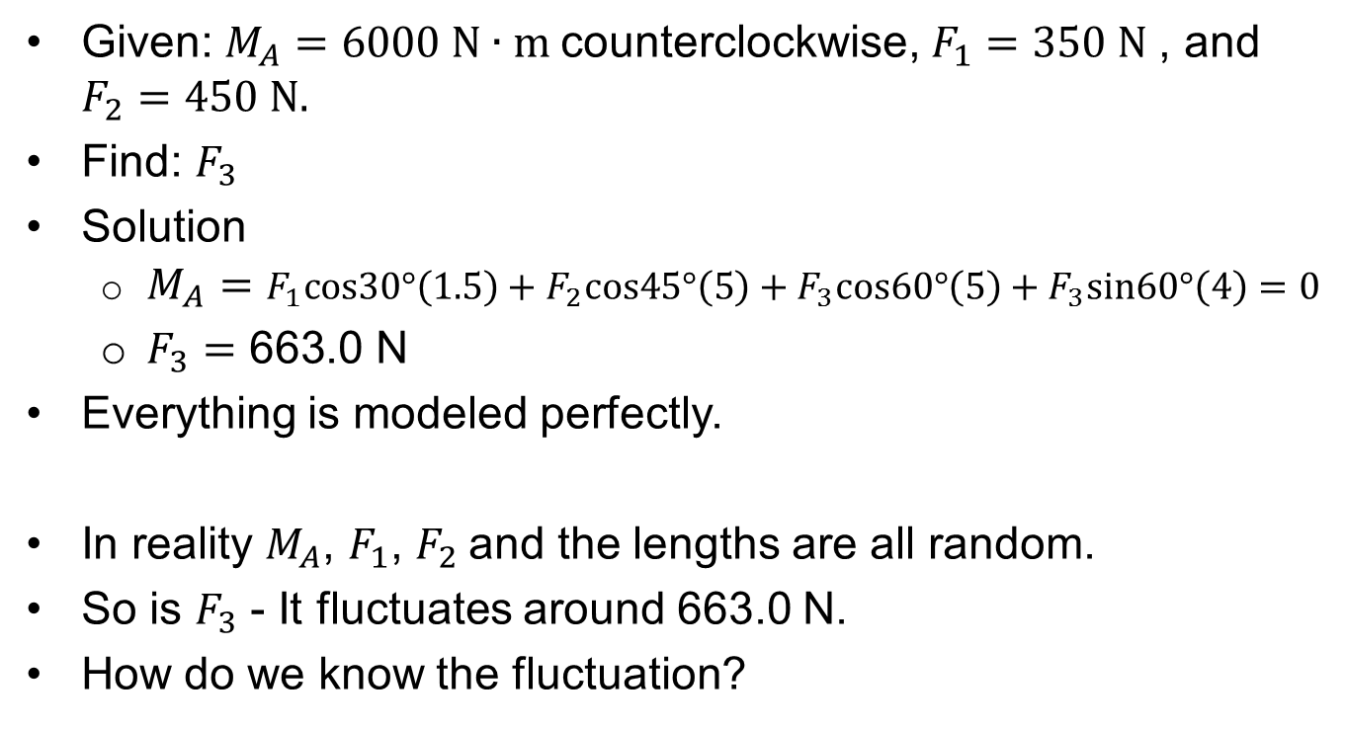




Uncertainty in Statics: An Example
Given: $M_{A}=6000 N∙m$counterclockwise, $F_{1}=350 N$, and $F_{2}=450 N.$
Find: $F_{3}$
Solution
  ${M_{A}=F}_{1}cos30°\left(1.5\right)+F_{2}cos45°\left(5\right)+F_{3}cos60°\left(5\right)+F_{3}sin60°\left(4\right)=0$
  $F_{3}=\text{663}\text{.0} \text{N}$
Everything is modeled perfectly.
In reality $M_{A}$, $F_{1}$, $F_{2}$and the lengths are all random.
So is $F_{3}$ - It fluctuates around 663.0 N.
How do we know the fluctuation?
$$F_{3}$$
$$60°$$
$$F_{1}$$
4 m
$$30°$$
A
$$M_{A}$$
1.5 m
3.5 m
$$F_{2}$$
$$45°$$

Slide 4
Where Does Uncertainty Come From?
Manufacturing Imprecision
- Dimensions of a structure
- Material properties
Environment
- Loading
- Temperature
- Different user conditions
- Wind, snow, etc.

Slide 5
Why Consider Uncertainty?
We know the true solution
We know the effect of uncertainty
We can make more reliability decisions
We can predict the chance of failure
If we consider uncertainties in the above example, we can design better cost-effective beams with sufficient reliability against failures with respect to strength, stiffness, etc.

Slide 6
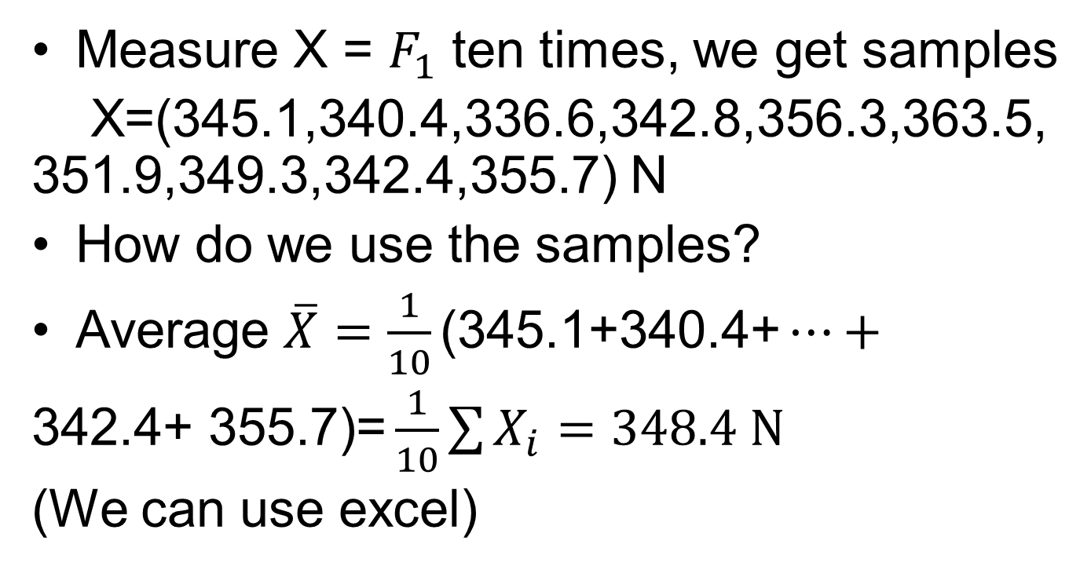
How Do We Model Uncertainty?
Measure X = $F_{1}$ ten times, we get samples
X=(345.1,340.4,336.6,342.8,356.3,363.5, 351.9,349.3,342.4,355.7) N
How do we use the samples?
Average $\overline{X}=\frac{1}{10}\text{(}\text{345.1}\text{+}\text{340.4}\text{+}…+$
$\text{342.4}\text{+ }\text{355.7}\text{)=}\frac{1}{10}\sum{X_{i}=348.4 N}$
(We can use excel)
$$F_{3}$$
$$60°$$
$$F_{1}$$
4 m
$$30°$$
A
$$M_{A}$$
1.5 m
3.5 m
$$F_{2}$$
$$45°$$

Slide 7
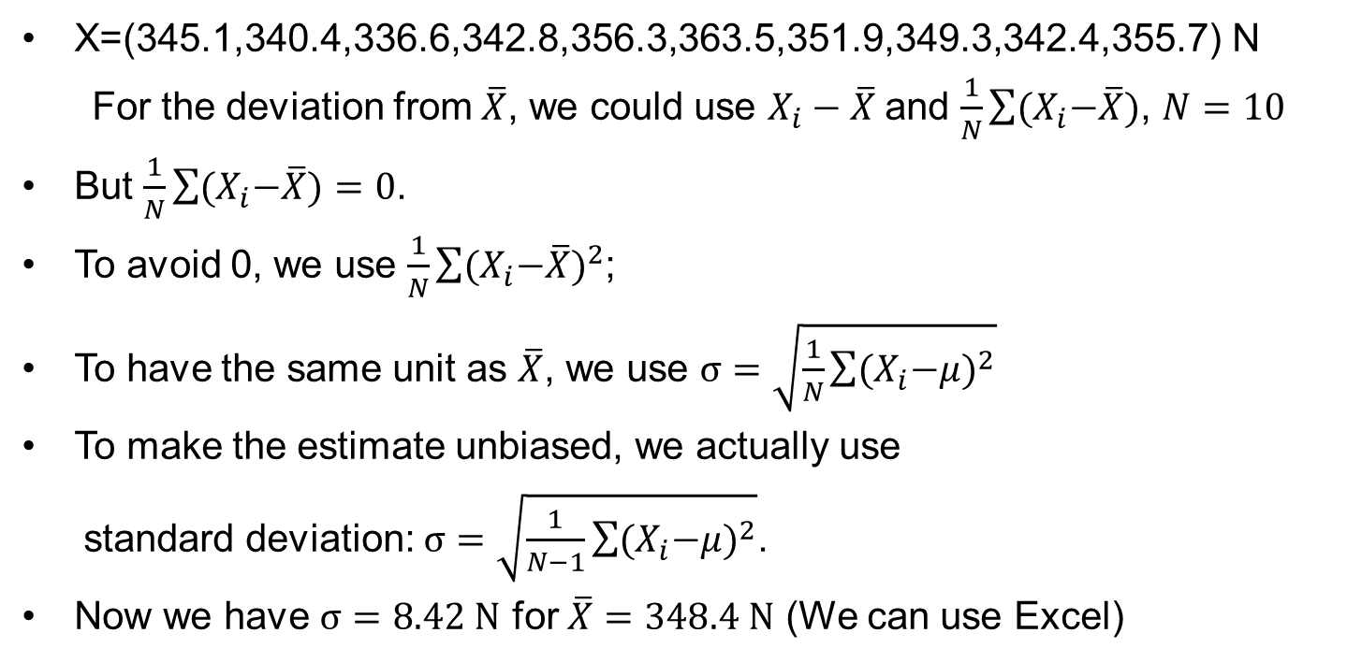
How Do We Measure the Dispersion (Uncertainty)?
$\text{X}\text{=(345.1,340.4,336.6,342.8,356.3,363.5,351.9,349.3,342.4,355.7) }\text{N}$
For the deviation from $\overline{X}$, we could use $X_{i}−\overline{X}$and $\frac{1}{N}\sum{{(X}_{i}−\overline{X})}$, $N=10$
But $\frac{1}{N}\sum{{(X}_{i}−\overline{X})=0}$.
To avoid 0, we use $\frac{1}{N}\sum{{{(X}_{i}−\overline{X})}^{2}}$;
To have the same unit as $\overline{X}$, we use $σ=\sqrt{\frac{1}{N}\sum{{{(X}_{i}−μ)}^{2}}}$
To make the estimate unbiased, we actually use
  standard deviation: $σ=\sqrt{\frac{1}{N−1}\sum{{{(X}_{i}−μ)}^{2}}}$.
Now we have $σ=8.42 N$ for $\overline{X}=348.4 N$ (We can use Excel)

Slide 8
More About Standard Deviation (std)
It indicates how data spread around the average
It is always non-negative
High std means
  High dispersion
  High uncertainty
  High risk

Slide 9
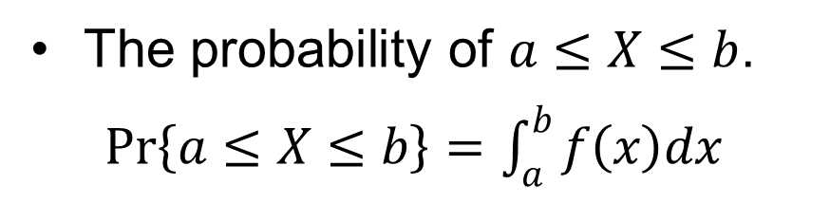
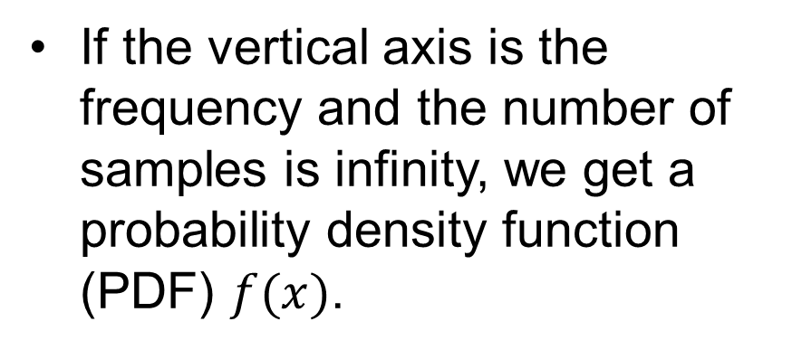
Probability Distribution
With more samples, we can draw a histogram.
If the vertical axis is the frequency and the number of samples is infinity, we get a probability density function (PDF) $f(x)$.
The probability of $a≤X≤b$.
$Pr\left\{a≤X≤b\right\}=\int_{a}^{b}{f\left(x\right)dx}$

Slide 10
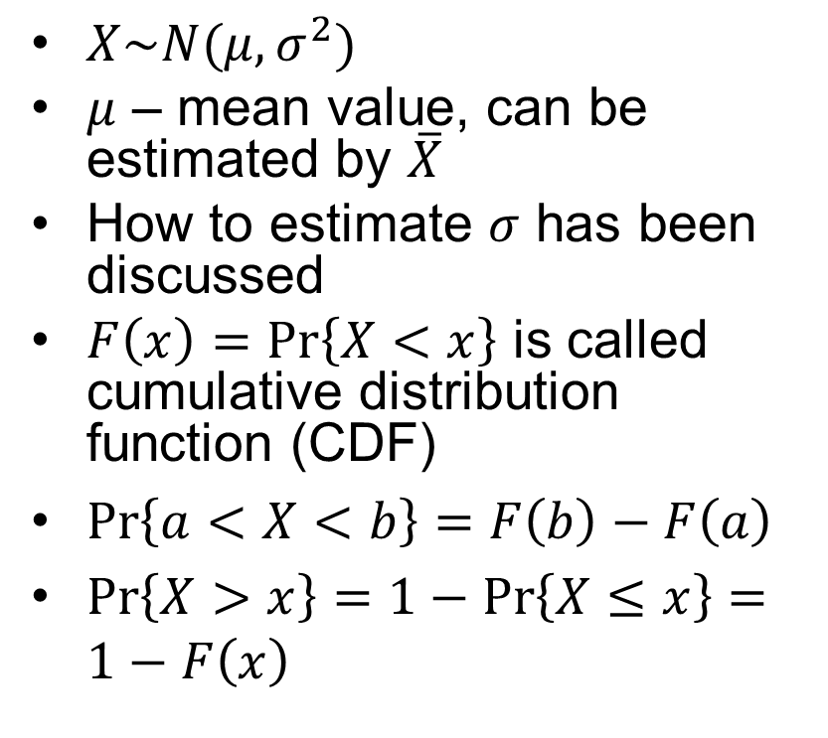
Normal Distribution
$X\sim N(μ,σ^{2})$
$μ$ – mean value, can be estimated by $\overline{X}$
How to estimate $σ$ has been discussed
$F\left(x\right)=Pr\left\{X<x\right\}$ is called cumulative distribution function (CDF)
$Pr\left\{a<X<b\right\}=F\left(b\right)−F\left(a\right)$
$Pr\left\{X>x\right\}=1−Pr\left\{X≤x\right\}=1−F\left(x\right)$

Slide 11

How to Calculate $F\left(x\right)?$
Use Excel
  NORMDIST(x,mean,std,cumulative)
  Cumulative=true

Slide 12
Example 1
1 | 1198.5
2 | 1192.5
3 | 1188.1
4 | 1190.2
5 | 1195.1
6 | 1198.7
7 | 1196.3
8 | 1190.7
9 | 1193.9
10 | 1192.2
11 | 1191.5
12 | 1199.2
13 | 1197.7
14 | 1194.1
15 | 1196.9
16 | 1193.0
17 | 1197.5
18 | 1194.9
19 | 1199.1
20 | 1192.6
The moment (in N∙m) acting on a beam was recorded 20 times.
Assume the moment is normally
distributed.
Questions
- Mean =? Std = ?
- What is the probability that the
beam has a moment greater than
1192.3 N∙m?

Slide 13
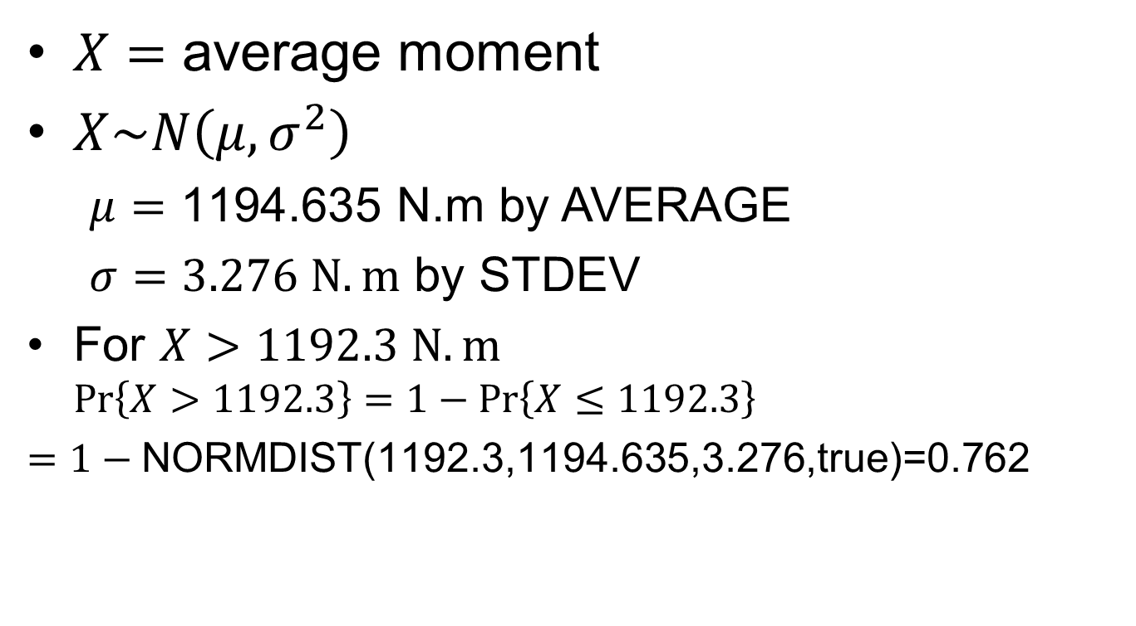
Solution: Use Excel
$X=$ average moment
$X\sim N\left(μ,σ^{2}\right)$
  $μ=\text{1}\text{194.635} \text{N}\text{.}\text{m}$ by AVERAGE
  $σ=3.276 N.m$ by STDEV
For $X>1192.3 N.m$ $Pr\left\{X>1192.3\right\}=1−Pr\left\{X≤1192.3\right\}$
  $=1−\text{NORMDIST}\text{(1192.3,1194.635,3.276,}\text{true}\text{)=0.7}$62

Slide 14
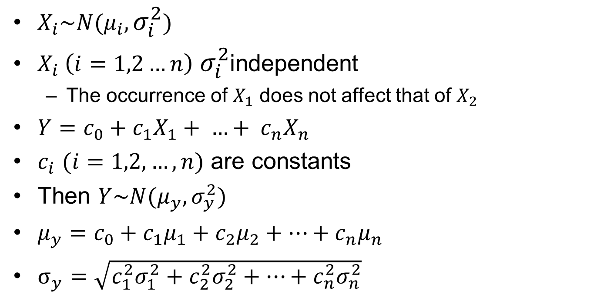
More Equations
$X_{i}\sim N(μ_{i},σ_{i}^{2})$
$X_{i} \left(i=1,2…n\right)$ $σ_{i}^{2}$independent
  The occurrence of $X_{1}$ does not affect that of $X_{2}$
${Y=c}_{0}+c_{1}X_{1}+ …+ c_{n}X_{n}$
$c_{i}$ $(i=1,2, …, n)$ are constants
Then $Y\sim N(μ_{y},σ_{y}^{2})$
$μ_{y}=c_{0}+c_{1}μ_{1}+c_{2}μ_{2}+…+c_{n}μ_{n}$
$σ_{y}=\sqrt{c_{1}^{2}σ_{1}^{2}+c_{2}^{2}σ_{2}^{2}+…+c_{n}^{2}σ_{n}^{2}}$

Slide 15
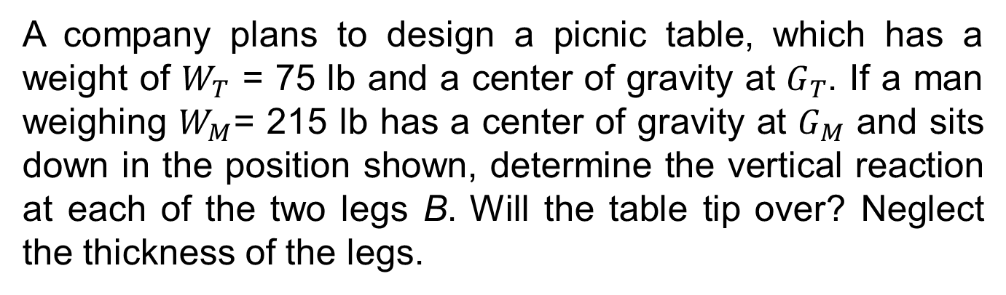
Example 2
A company plans to design a picnic table, which has a weight of $W_{T}$ = 75 lb and a center of gravity at $G_{T}$. If a man weighing $W_{M}$= 215 lb has a center of gravity at $G_{M}$ and sits down in the position shown, determine the vertical reaction at each of the two legs B. Will the table tip over? Neglect the thickness of the legs.
G_{T}
G_{M}
A
B
7 in
22 in
22 in

Slide 16





Example cont.
$$W_{T}$$
Solution
$\sum{M_{A}=0 (1) }$
$2N_{B}\left(44\right)+W_{M}\left(7\right)−W_{T}\left(22\right)=0 (2)$
$N_{B}=1.648 lb (3)$
Since $N_{B}$ is positive, the table will not tip over.
$$W_{M}$$
A
B
7 in
22 in
22 in
$${2N}_{A}$$
$${2N}_{B}$$

Slide 17
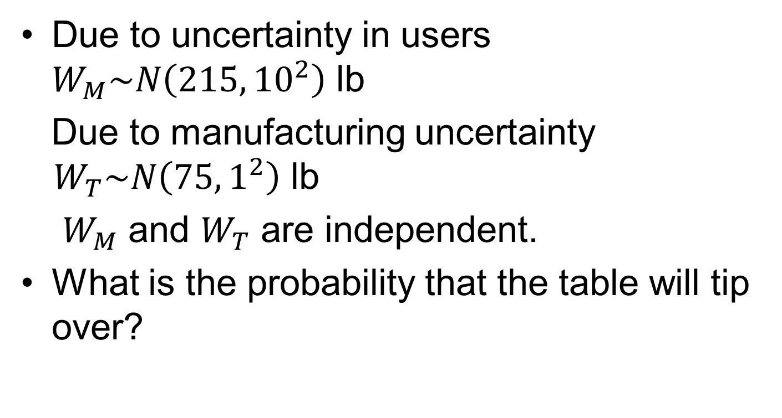
If Consider Uncertainty
Due to uncertainty in users $W_{M}\sim N\left(215,{10}^{2}\right)$ lb
Due to manufacturing uncertainty $W_{T}\sim N\left(75,1^{2}\right)$ lb
$W_{M}$ and $W_{T}$ are independent.
What is the probability that the table will tip over?

Slide 18
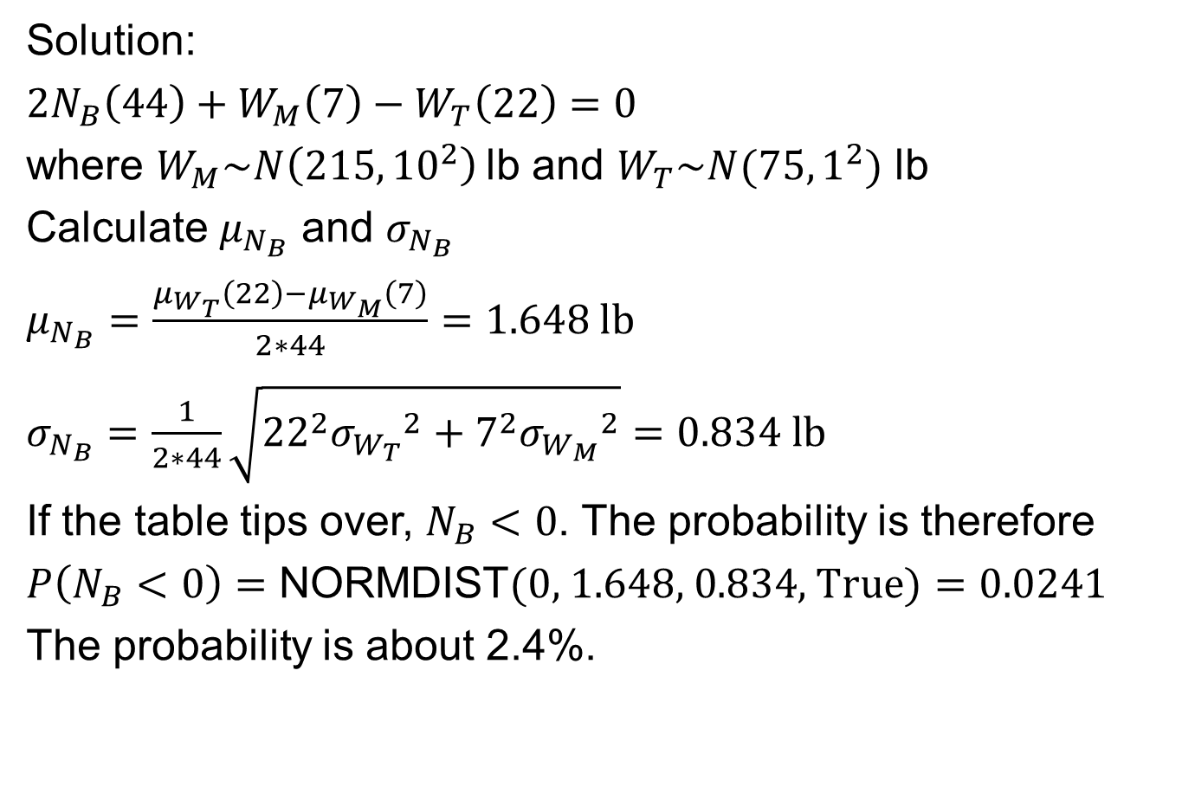
Solution:
$2N_{B}\left(44\right)+W_{M}\left(7\right)−W_{T}\left(22\right)=0$
where $W_{M}\sim N\left(215,{10}^{2}\right)$lb and $W_{T}\sim N(75,1^{2})$ lb
Calculate $μ_{N_{B}}$ and $σ_{N_{B}}$
$μ_{N_{B}}=\frac{μ_{W_{T}}\left(22\right)−μ_{W_{M}}\left(7\right)}{2∗44}=1.648 lb$
$σ_{N_{B}}=\frac{1}{2∗44}\sqrt{{22}^{2}{σ_{W_{T}}}^{2}+7^{2}{σ_{W_{M}}}^{2}}=0.834 lb$
If the table tips over, $N_{B}<0$. The probability is therefore
$P\left(N_{B}<0\right)=\text{NORMDIST}\text{(0, 1.648, 0}\text{.834, }\text{True}\text{)}=0.0241$
The probability is about 2.4%.

Slide 19
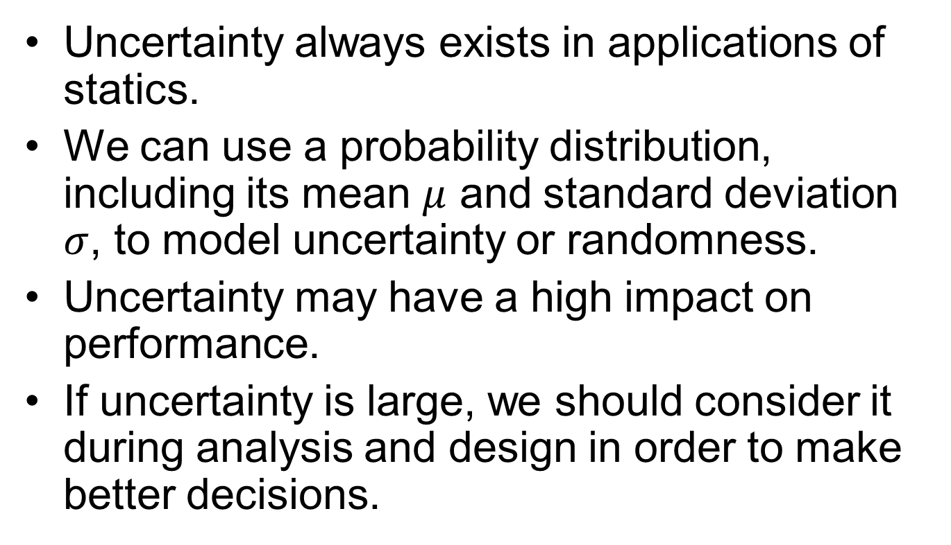
Conclusions
Uncertainty always exists in applications of statics.
We can use a probability distribution, including its mean $μ$ and standard deviation $σ$, to model uncertainty or randomness.
Uncertainty may have a high impact on performance.
If uncertainty is large, we should consider it during analysis and design in order to make better decisions.

